Slide 1

SAHAKAR MAHARSHI SHANKARRAO MOHITE-PATIL INSTITUTE OF TECHNOLOGY AND RESEARCH AKLUJ
A
PRESENTAION ON
“VoiceVerse Translator – Real-Time AI-Powered Voice Translation System”
Name of student
Mr. Bodakhe Sanket Eknath
Mr. Bhaskare Rushikesh Nagesh
Mr. Sul Tanish Bhagwat
Mr. Kshirsagar Gajanan Santosh
Under guidance
of
Prof. S. D. Pandhare

Slide 2
Content
Introduction
Literature Survey
Problem Statement
Existing System
Proposed System
Methodology
Objective
Software Hardware Specification
Advantages
Conclusion
References

Slide 3
Introduction
VoiceVerse Translator is an AI-based system that helps people talk to each other in different languages. It listens to what a person says, translates the speech into another language, and speaks it out instantly.The system uses speech recognition to understand spoken words, AI translation to change the language, and text-to-speech to speak the translation clearly.This project makes communication easier for people who don’t share the same language. It can be used in travel, education, meetings, or customer service to help remove language barriers and connect people around the world.

Slide 4
Literature Review
Ref. No | Reference Papers/Books Name | Author Name | Description
1. | Real-Time Speech-to-Speech Translation for PDAs | R. Prasad, K. Krstovski, F. Choi, S. Saleem, | Real-Time Speech-to-Speech Translation for PDAs is a system that helps people who speak different languages communicate easily. It listens to what a person says, converts the speech into text, translates it into another language, and then speaks it out loud in that language — all in real time.
2. | Real-Time Text & Speech Translation Using Sequence To Sequence Approach | Dikshita Patel, Minakshi Kudalkar , Shashank Gupta , Renuka Pawar | The paper “Real-Time Text & Speech Translation Using Sequence-to-Sequence Approach” describes a system that helps people talk or chat in different languages in real time. It listens to speech, turns it into text, translates it into another language, and then speaks it back instantly. The system uses a CNN-based model for faster and more accurate translation.

Slide 5
Ref. No | Reference Papers/Books Name | Author Name | Description
3. | Real Time Voice Translator | Darshan Shilvant, Ejaz Sayyed, Sarang Jagdale, Prof. Rachika Waghmare | A Real-Time Voice Translator is a system that listens to what a person says in one language, translates it instantly into another language, and then speaks it out loud. It helps people who speak different languages communicate easily without waiting or needing a third person. The translator uses speech recognition, language translation, and text-to-speech technology to give fast and accurate results, making conversations smooth and natural
4. | REAL TIME LANGUAGE TRANSLATOR | Siddhi Divate, Gajashree Biradar, Amruta Patole, Nikat Attar | A Real-Time Language Translator is a system that quickly translates spoken or written words from one language to another as the conversation happens. It uses speech recognition to understand the input, machine translation to convert it, and text-to-speech to speak the translated output

Slide 6
Problem Statement
In today’s world, people often need to communicate with others who speak different languages. However, language barriers make it difficult to understand each other and share ideas. Existing translation tools are often slow, require typing, or do not work well in real-time conversations.

Slide 7
Existing System
In the existing systems, most language translators work through text input or pre-recorded audio. Users have to type or record their message first and then wait for the translation. Some mobile apps, like Google Translate, can translate speech, but they often need internet access, may have delay in real-time translation, and sometimes give inaccurate results depending on accent or background noise.

Slide 8
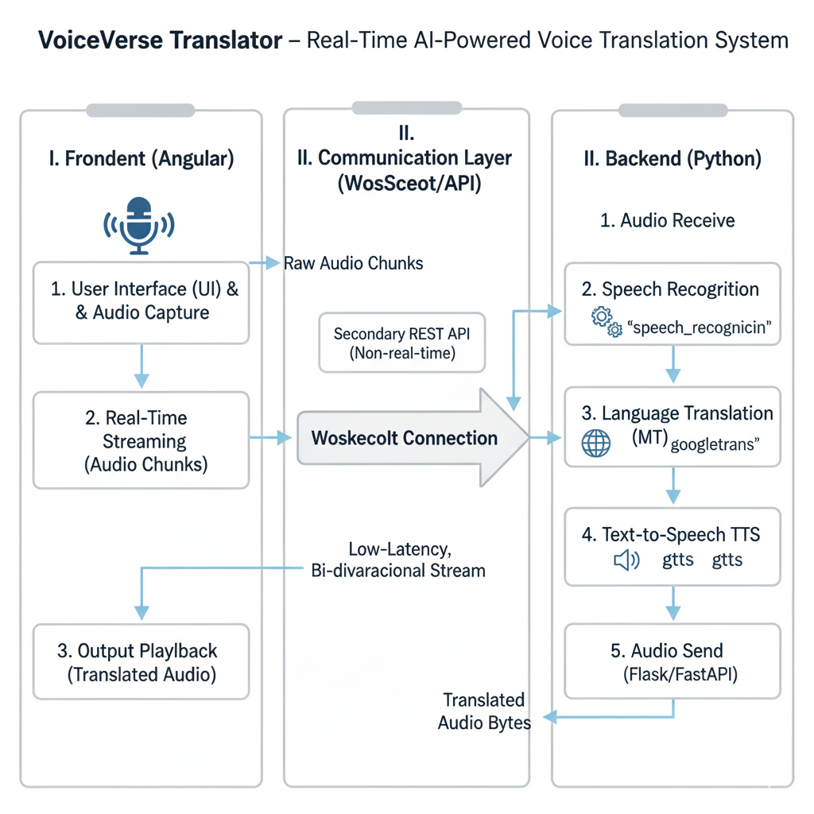
Methodology

Slide 9
Objective
To develop a system that can translate spoken language in real time.
To use AI and speech recognition for accurate voice detection and translation.
To convert the translated text into natural-sounding speech.
To help people communicate easily across different languages.
To create a fast, user-friendly, and efficient translation tool for daily use.

Slide 10
Software & Hardware Requirement
Hardware Requirements:
Processor : Intel i5 or more
Speed : 2.4 GHz
RAM : 4GB (min)
Hard Disk : 50 GB
Software Requirements:
Operating System : Windows 11
Language : Python, Angular, My SQL

Slide 11
Advantages
Removes language barriers – Helps people talk easily in different languages.
Real-time translation – Translates speech instantly without long delays.
AI-powered accuracy – Gives more correct and natural translations.
Voice output – Speaks the translated text clearly for better communication.
Easy to use – Simple interface that anyone can use.
Useful in many areas – Helpful for travel, meetings, education, and customer support.

Slide 12
Conclusion
The VoiceVerse Translator helps people talk to each other even if they speak different languages. It listens to the voice, translates it quickly, and speaks it in another language.This project makes communication easy, fast, and clear. It can be very useful for travel, learning, and talking to people from other countries.

Slide 13
Reference
S. Divate, G. Biradar, A. Patole, and N. Attar, “Real Time Language Translator,” International Research Journal of Modernization in Engineering Technology and Science (IRJMETS), vol. 5, no. 12, pp. [insert page numbers if known], Dec. 2023
D. Shilvant, E. Sayyed, S. Jagdale, and R. Waghmare, “Real Time Voice Translator,” International Journal of Advanced Research in Science, Communication and Technology (IJARSCT), vol. 4, no. 1, pp. [insert page numbers if known], Apr. 2024.
D. Patel, M. Kudalkar, S. Gupta, and R. Pawar, “Real-Time Text and Speech Translation Using Sequence-to-Sequence Approach,” Proceedings of the Third International Conference on Inventive Research in Computing Applications (ICIRCA-2021).
R. Prasad, K. Krstovski, F. Choi, S. Saleem, P. Natarajan, M. Decerbo, and D. Stallard, “Real-Time Speech-to-Speech Translation for PDAs,” BBN Technologies, Cambridge, MA, USA

Slide 14

For more information of project
https://github.com/sanketbodakhe68/finel-year-projet.git

